Slide 1

The Azure Migration Story
Sarah Lean

Slide 2

Sarah Lean
Cloud Solution Architect
Blogger | Curler | Photographer | Book Lover | Runner | Speaker | STEM Ambassador
13+ years experience in IT
@TechieLass
https://www.techielass.com

Slide 3
Software and hardware refresh
Security threats
Urgent capacity needs
Compliance
Quickly integrate acquisitions
Application innovation
Migration drivers
Software end of support
Datacenter contracts expiry
Notes:
There are a number of reasons that are driving people to look at Azure

Slide 4
Extended security updates for 2008 and 2008 R2 – free in Azure
IaaS: Move to Azure VMs, get 3 more years of extended security updates at no additional charge
PaaS: Move SQL Server to Azure SQL Database Managed Instance (version free, fully managed, no patching needed)
Use Azure Hybrid Benefit to maximize on-premises investments
Migrate to Azure
SQL Server 2008 and 2008 R2
Extended support
ends July 9, 2019
Windows Server 2008 and 2008 R2
Extended support
ends January 14, 2020
Upgrade to current Windows Server/ SQL Server versions
OR
Buy 3 more years of extended security updates on 2008/2008 R2
2018
2019
2020
Stay on-premises

Slide 5
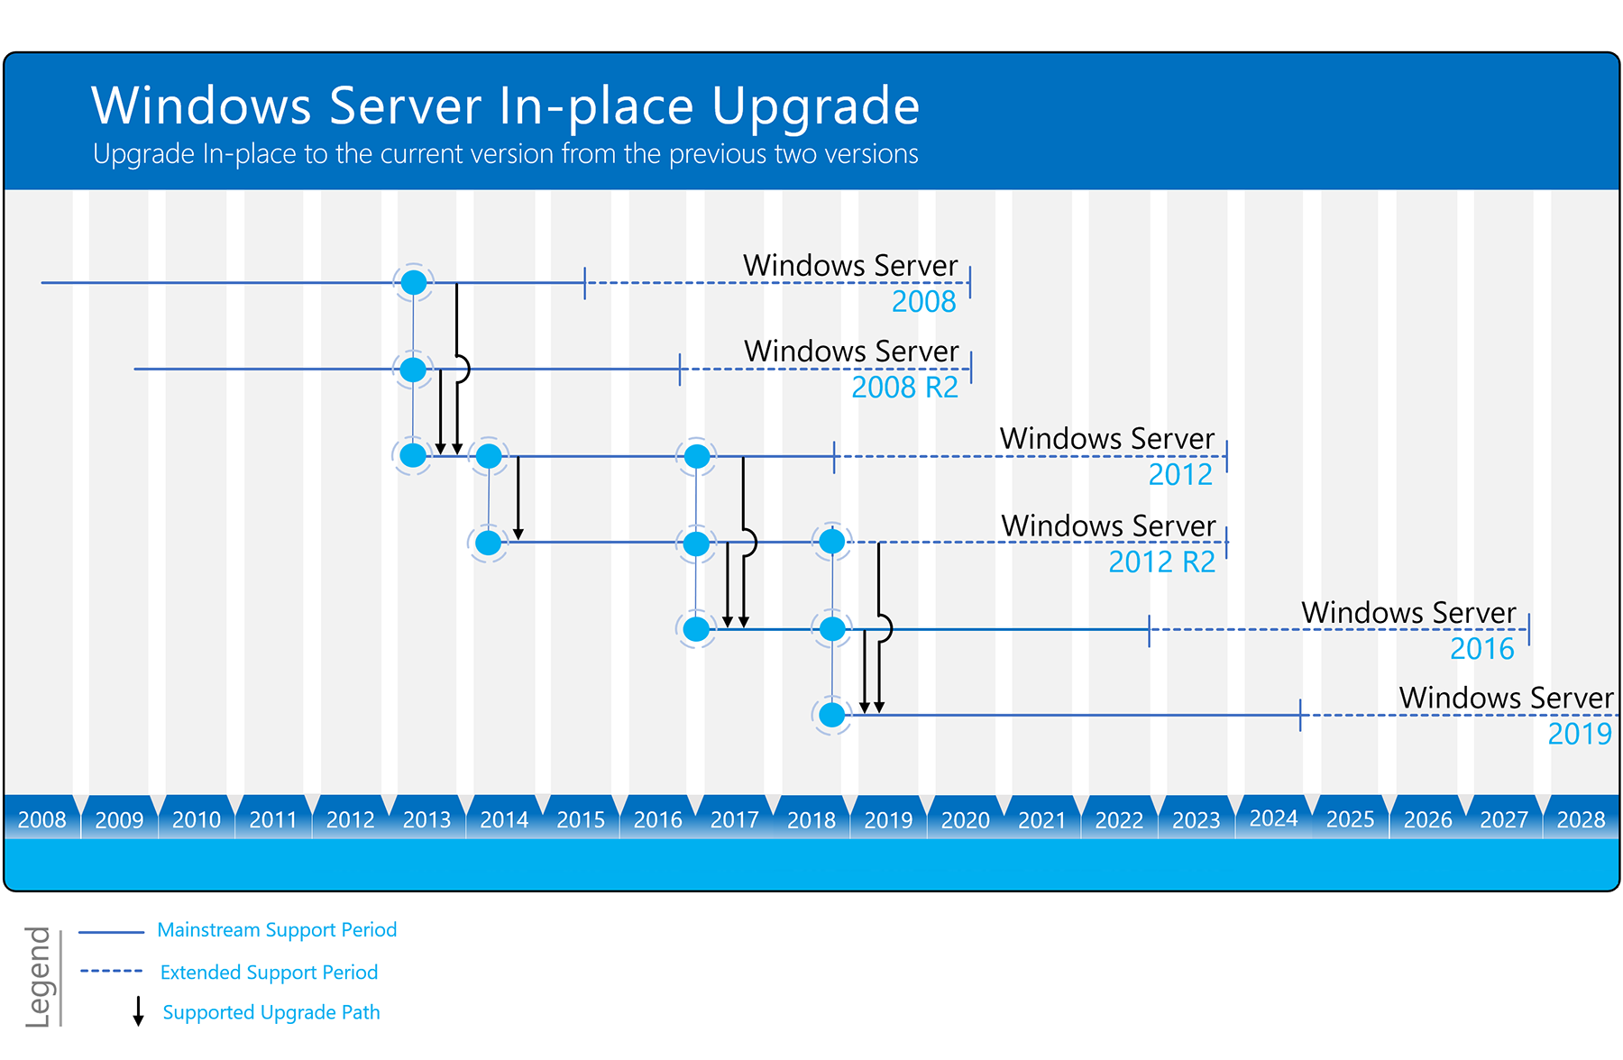
https://www.microsoft.com/upgradecenter

Slide 6

















Choice of tools for every stage and every requirement
Goal is successful Azure migration: Pick the right tool for the job
Assess
Migrate
Optimize
Secure & Manage
Azure Migrate
Azure Site Recovery (ASR)
Azure Cost Management
Azure Advisor
Azure Security & Management
(e.g., Blueprint, Security Center, Backup, Monitor)
Data Migration Assistant (DMA)
Azure Database Migration Service
SQL Server Migration Assistant (SSMA)
Azure Data Box
We embrace ISV solutions

Slide 7
Azure Migrate

Slide 8

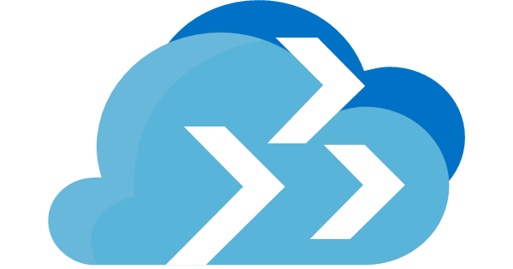
Assess your environments with Azure Migrate
Assess
App performance history
App configuration data
Applicable discounts and offers
(e.g., Azure Hybrid Benefit, RI)
Target Azure location
Azure suitability analysis
(e.g., compatibility)
Rightsized Azure resource model
Azure cost estimates
App dependency map
Azure Migrate
VMware and Hyper-V (NEW!) assessments | Windows and Linux assessments | Free, built in service

Slide 9
Appliance-based
No pre-setting or pre-configuring a machine
No installation of pre-requisite software

Slide 10
Light discovery
No agents to install and no firewall ports to open

Slide 11
Data Collected
Cores
Memory
Disks
Disk Sizes
Network Adapters
CPU usage
Memory usage
Disk IOPS
Disk throughput (MBps)
Network output (MBps)
VM Name
IP Address

Slide 12
Deep discovery
Agent-based
No guesswork anymore
No need to remember which machine belongs to which app

Slide 13
Service Map
Presents a view of your servers as you think of them – as interconnected systems
Discovers and maps server and process dependencies in real-time
Can monitor cloud and on premises servers

Slide 14
Migration Assessment
Three stages
Suitability Analysis
Sizing
Monthly Cost estimation

Slide 15
Supported Geographies
Geography | Storage location
Azure Government | US Gov Virginia
Asia | Southeast Asia
Europe | North Europe or West Europe
United States | East US or West Central US

Slide 16
Azure Site Recovery Migration

Slide 17


Replicate on-premises Azure
Key features include:
Automated VM protection and replication
Remote health monitoring
Customizable plans
No-impact testing
Orchestrated recovery of tiered applications
Support for heterogeneous environments
Azure Site Recovery
Orchestration and replication
Microsoft System Center
Enterprise, SMB, and HSP primary site
Windows Server
Linux server
VMware/
Physical

Slide 18
Replication for Hyper-V
Hyper-V Server
Azure Site Recovery
Source: Hyper-V
443 (HTTPS)
Data channel
Microsoft Azure
Microsoft Azure Recovery Services Agent
Replicates data to Azure
Public internet or ExpressRoute with public peering
Documentation: https://aka.ms/asr_hyperv
Videos: https://aka.ms/asr_videos

Slide 19



Replication for VMware
443 (HTTPS)
Config server
Azure Site Recovery
Process server
443 (HTTPS)
9443 (HTTPS)
Data channel
Microsoft Azure
Source: VMware VMs and physical servers
Public internet or ExpressRoute with public peering
Documentation: http://aka.ms/asr_vmware
Videos: https://aka.ms/asr_videos
Notes:
Documentation: http://aka.ms/asr_vmware
Videos: https://aka.ms/asr_videos

Slide 20
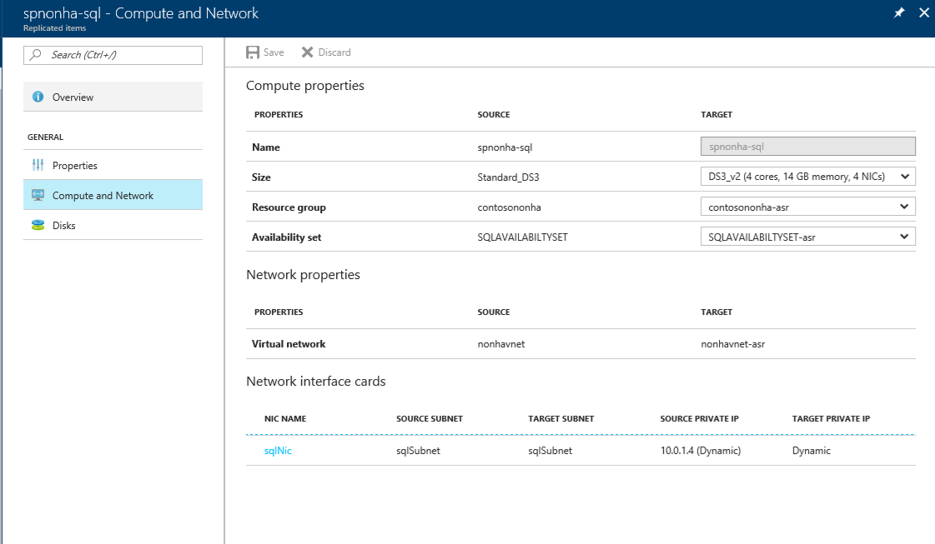
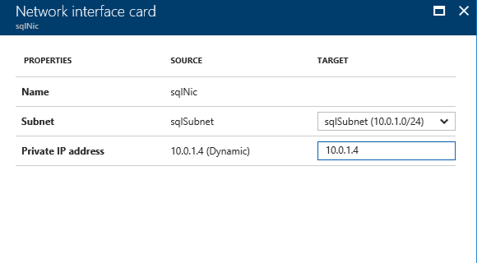
Networking
Retain IP or change IP

Slide 21
Compute
Change size

Slide 22
Pricing
Price for first 31 days
Price after 31 days
Azure Site Recovery to customer
-
Free
£11.94/month per instance
owned sites
protected
Azure Site Recovery to Azure
Free
£18.64/month per instance
protected
https://azure.microsoft.com/en-gb/pricing/details/site-recovery/

Slide 23

What is Windows Admin Center?

Slide 24
Management before Windows Admin Center

Slide 25

Management before Windows Admin Center
Windows Server 2016, 2012 R2, 2012
Windows Server Core
1709, 2016, 2012R2, 2012
Windows 10 Client

Slide 26

Management before Windows Admin Center
Windows Server 2016, 2012R2, 2012
Windows Server Core
1709, 2016, 2012R2, 2012
Windows 10 Client

Slide 27
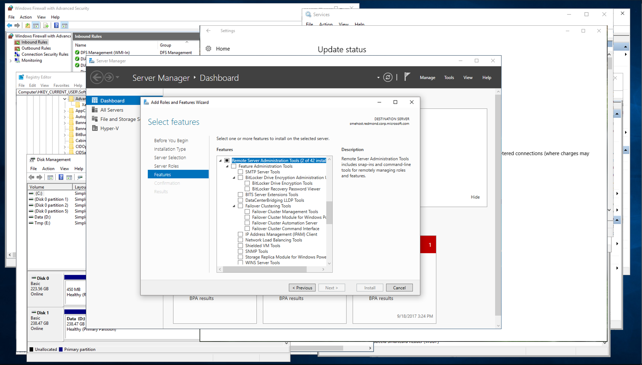
Management before Windows Admin Center
Windows Server 2016, 2012R2, 2012
Windows Server Core
1709, 2016, 2012R2, 2012
Windows 10 Client

Slide 28
Management before Windows Admin Center
Windows Server 2016, 2012 R2, 2012
Windows Server Core
1709, 2016, 2012R2, 2012
Windows 10 Client

Slide 29
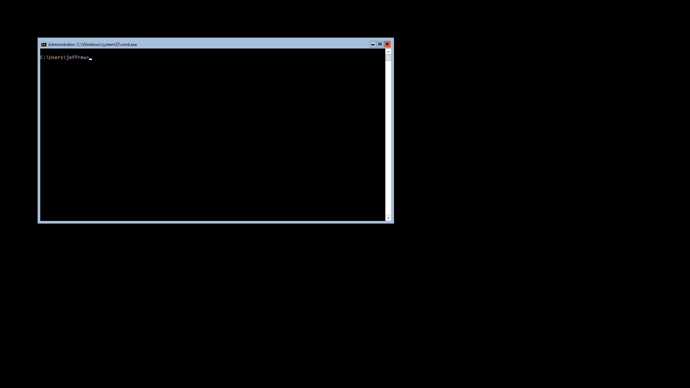
Management before Windows Admin Center
Windows Server 2016, 2012R2, 2012
Windows Server Core 1709, 2016, 2012 R2, 2012
Windows 10 Client

Slide 30
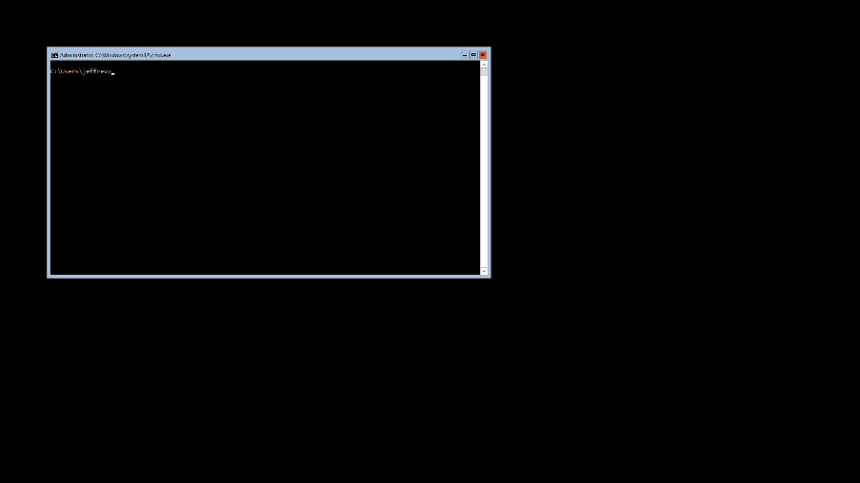
Management before Windows Admin Center
Windows Server 2016, 2012 R2, 2012
Windows Server Core 1709, 2016, 2012 R2, 2012

Slide 31
Management before Windows Admin Center
Windows Server 2016, 2012R2, 2012
Windows Server Core 1709, 2016, 2012R2, 2012
Windows 10 Client

Slide 32

Management before Windows Admin Center
Windows Server 2016, 2012R2, 2012
Windows Server Core 1709, 2016, 2012R2, 2012
Windows 10 Client

Slide 33
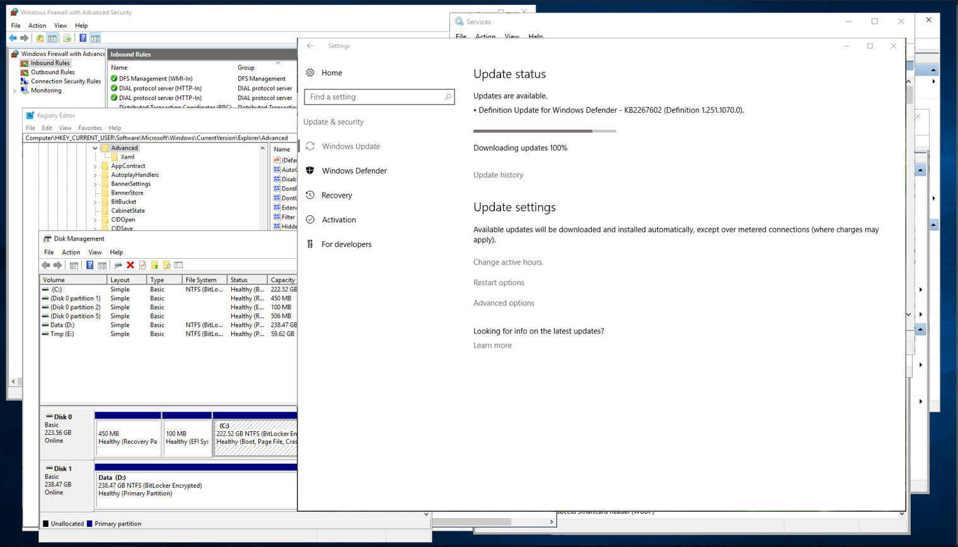
Management before Windows Admin Center
Windows Server 2016, 2012R2, 2012
Windows Server Core 1709, 2016, 2012R2, 2012
Windows 10 Client

Slide 34
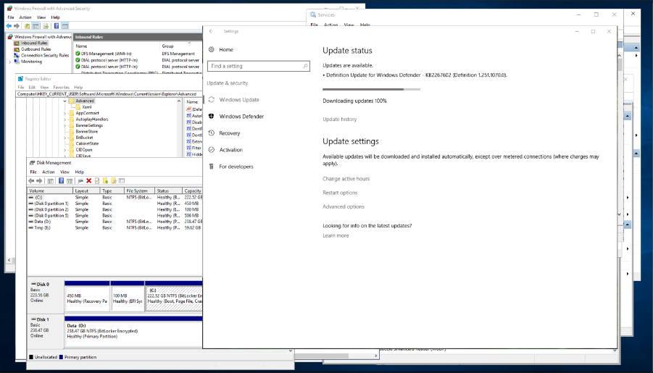
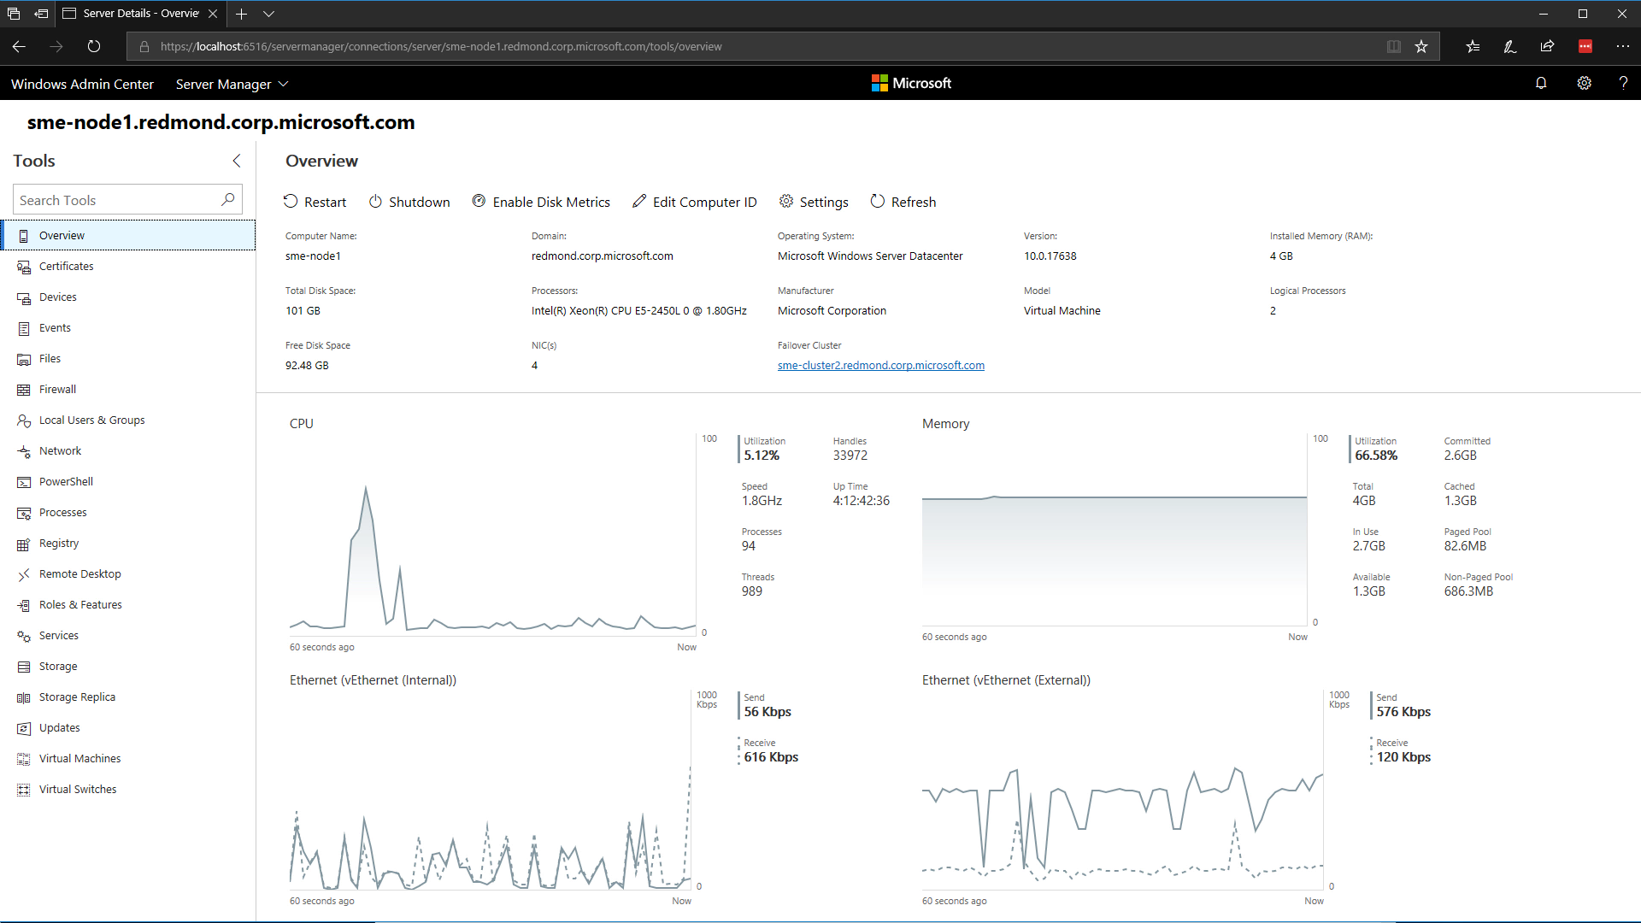
Management with Windows Admin Center
Simplified – Integrated – Secure – Cloud-ready
Windows Server 2016, 2012 R2, 2012
Windows Server Core 1709, 2016, 2012 R2, 2012
Windows 10 Client

Slide 35
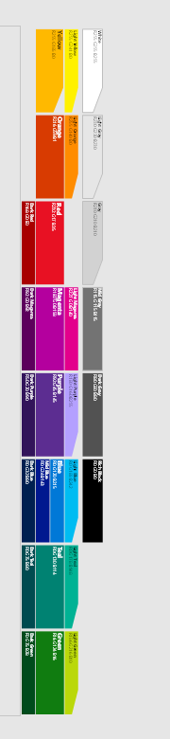



Smaller deployments for small-to-medium business, remote/branch office.
Larger deployments for enterprises, hosters, and service providers.
Cloud for hybrid IT management as a service.
Azure
Operations Management Suite
System Center
IBT
WAC
WAC
“In-Box” Tools
IBT
Windows Admin Center
Windows Server
Windows Server
Windows Server

Slide 36










Windows Admin Center Architecture
Internet
On-Premises
Client browser
HTTPS
Web server
Honolulu
Gateway
PowerShell / WMI over WinRM
Managed nodes
Notes:
Locally deployed, browser based
Gateway can be installed on:
Windows 10
Windows Server 2019 (Insider Builds)
Windows Server, version 1803
Windows Server, version 1709
Windows Server 2016
Manages:
Windows 10
Windows Server 2019 (Insider Builds)
Windows Server, version 1803
Windows Server, version 1709
Windows Server 2016
Windows Server 2012 R2
Windows Server 2012

Slide 37

https://aka.ms/sarahnfp
Thank you | Q&A
Sarah.Lean@Microsoft.com
@Techielass

